Slide 1
Eco Lifestyle Agent
AICTE PROJECT
Presented by :
Rahul Patel
Oriental College Of Technology, Bhopal

Slide 2
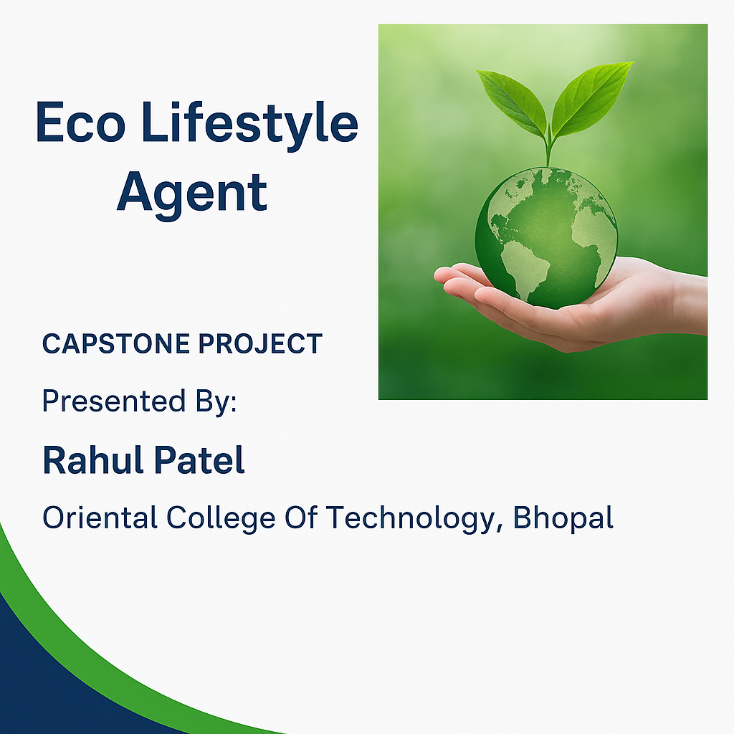
Cover Design

Slide 3
Outline
• Problem Statement
• Proposed Solution
• Technology Used
• IBM Cloud Services
• Wow Factor
• End Users
• System Architecture
• Algorithm & Deployment
• Results
• Conclusion
• Future Scope
• GitHub Link
• IBM Certifications

Slide 4
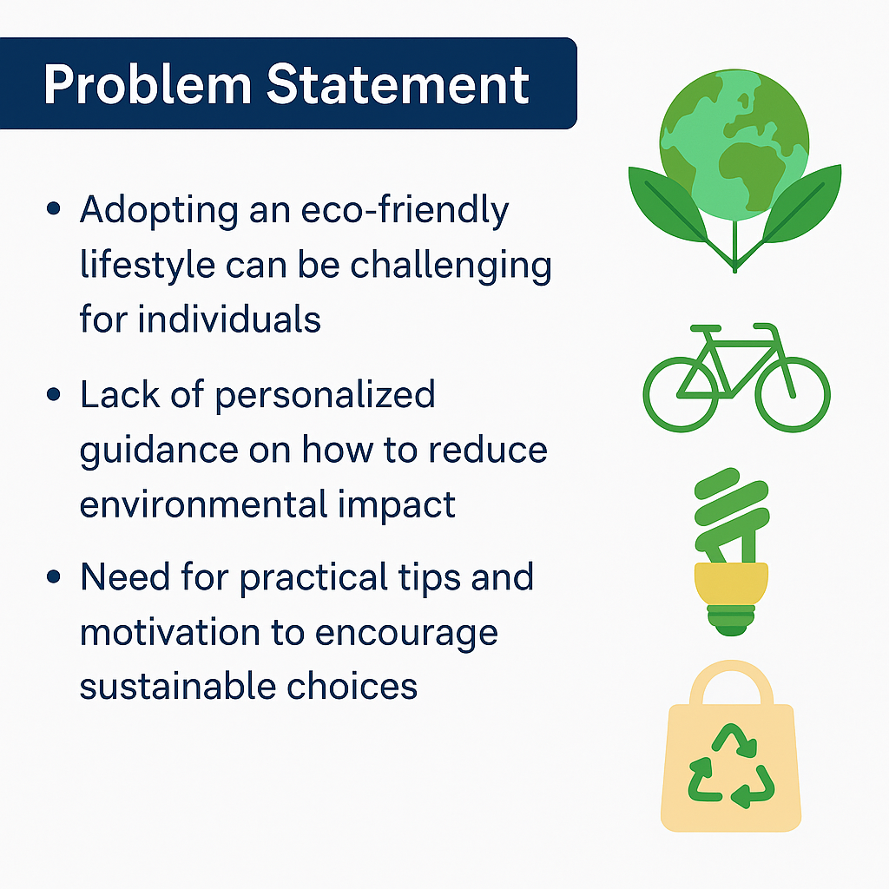
Problem Statement

Slide 5
PROPOSED SOLUTION
Interacts naturally with users using NLP.
Learns from interactions and adapts behavior.
Provides multi-platform support.
Operates autonomously and collaboratively.

Slide 6
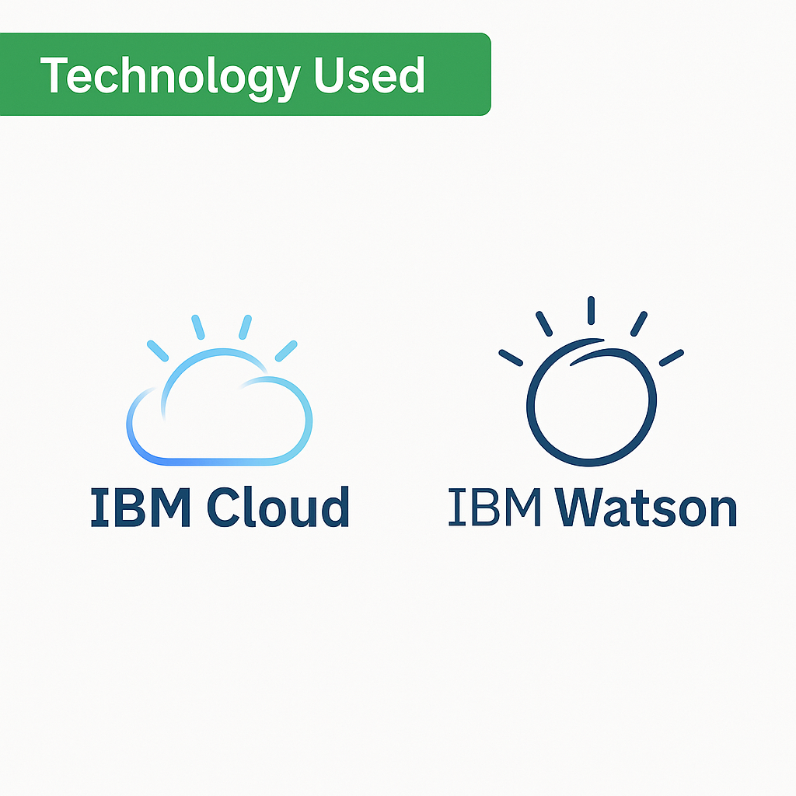
Technology Used

Slide 7
IBM CLOUD SERVICES
IBM Watson Assistant (Conversational AI)
IBM Cloud Object Storage
IBM Cloud Functions (Serverless)
Retrieval Augmented Generation (RAG)
IBM Granite Model

Slide 8
WOW FACTOR
AI agents can train themselves on user interactions
Adaptive response generation using live feedback
Voice-enabled interaction with sentiment awareness
Real-time collaboration between agents
Accessible across devices (web, mobile, wearable)

Slide 9
END USER
Students: Personalized learning support
Recruiters: Smart candidate filtering and ranking
Companies: Automated onboarding, HR assistants
Job Seekers: Guided resume building, job matching
Administrators: Insights dashboard and automation

Slide 10
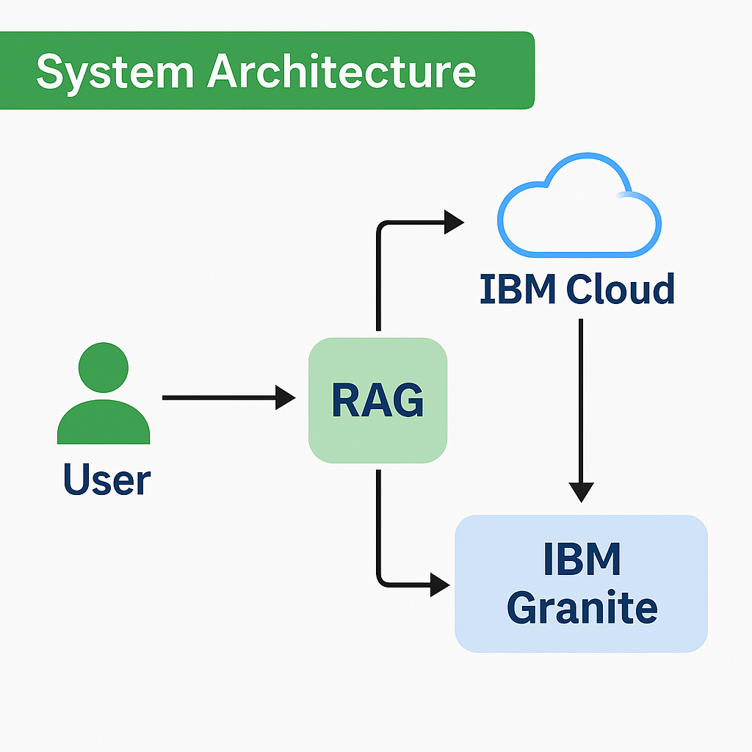
System Architecture

Slide 11
ALGORITHM & DEVELOPMENT
Algorithms: BERT for NLP, KNN for recommendation
Deployment:
Backend containerized using Docker
CI/CD via GitHub Actions
IBM Cloud Kubernetes cluster for deployment
Domain linked and monitored via IBM Cloud Monitor

Slide 12
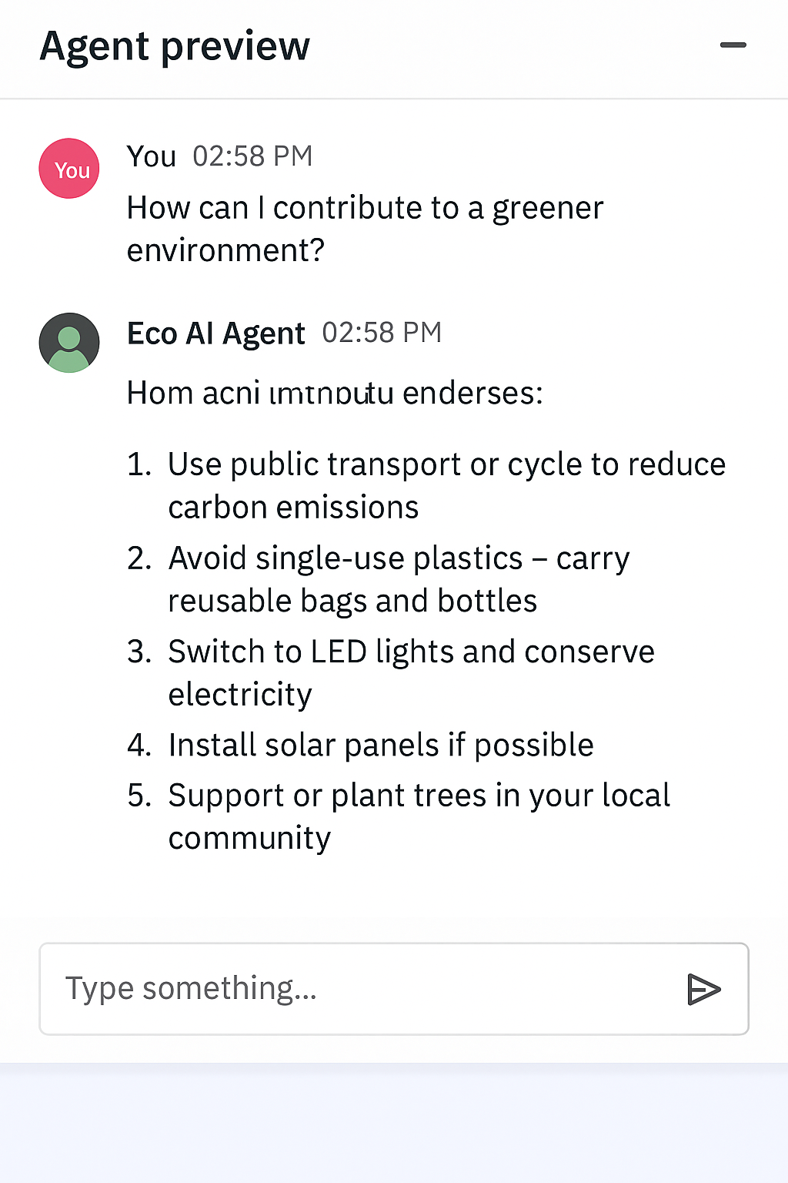
RESULTS
RESULTS

Slide 13
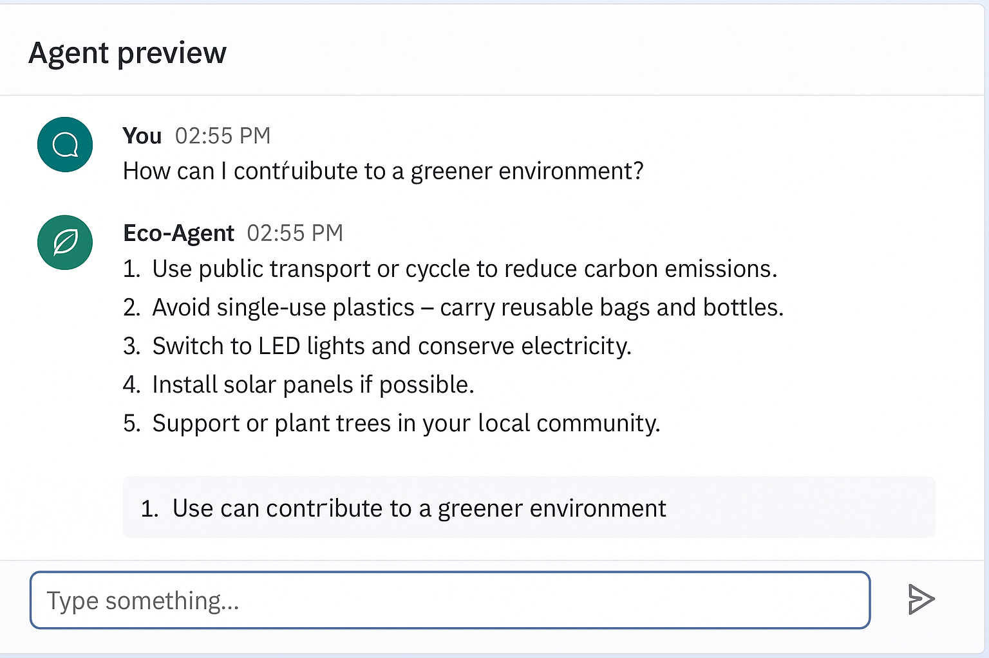

Slide 14
CONCLUSION
The AI Agent Ecosystem demonstrates how intelligent agents can collaborate to solve real-world problems efficiently.
The deployment on IBM Cloud ensures high availability, security, and manageability.
User interaction and feedback show positive adoption potential.
The system can reduce human effort in decision-making, monitoring, and task execution.
It highlights the synergy between multiple agents and services working in real-time.

Slide 15
FUTURE SCOPE
Integrate with IoT devices for real-time data sensing and adaptive behavior.
Use Natural Language Understanding (NLU) to improve agent-user communication.
Train agents with reinforcement learning for better autonomous decision-making.
Enable cross-platform support (mobile/web/voice assistants).
Incorporate blockchain for secure and transparent agent communication.
Scale the ecosystem globally using multi-cloud or hybrid cloud strategies.

Slide 16
IBM Certifications Details
• Getting Started with AI - Jul 17, 2025
• Journey to Cloud - Jul 19, 2025
• RAG Lab with LangChain - Jul 30, 2025

Slide 17
GITHUB LINK
https://github.com/major2908/Eco-LifeStyle-AI-Agent

